Slide 1
JKU Roadmap – CO2 neutral university
LIT Breakfast Briefing – 13 June 2023
Melanie Knöbl, Simon Moser, Katharina Rusch

Slide 2
Outline
Overview
What is meant by climate neutrality?
What is a roadmap?
Designing a roadmap
What happened so far?
Comparison with other universities
Data collection for JKU
Next steps

Slide 3
Energieinstitut an der JKU
Non-university research institution with a multidisciplinary structure.
The multidisciplinary cooperation of our three departments enables a comprehensive and interdisciplinary holistic analysis of the (future) topic of energy.
energy economics
energy law
energy technology
40 employees investigate an energy system that positively influences living, economic and environmental spaces, strengthens European economies and reduces fossil energy sources as far as possible.

Slide 4
Overview
Austria's governments target for achieving climate neutrality: 2040
most universities are not climate neutral yet
→ high potential for CO2 reduction (esp. energy and mobility sectors)
JKUs performance agreement: achieving CO2 neutrality by 2030
Energy Institute at the JKU was assigned in order to support the JKU team with scientific advice to create a roadmap

Slide 5
You may ask yourself:
Was is meant by climate neutrality?
What is a roadmap?

Slide 6
What is meant by…
…climate neutrality?
ISO 14068: Carbon neutrality
Specific period, in which no new GHG emissions are left into the atmosphere
Residual emissions have to be compensated
Projects must comply with guidelines
ClimCalc Tool to measure GHG emissions
…a roadmap?
Roadmap
Preparatory nature
Rough planning of steps to be taken
Over a long period
Roadmap development supported through workshops and feedback sessions
Stakeholders = knowledge carriers and acting participants
Predefined system boarders: Hauptcampus, Campus Hagenberg, Med-Campus incl. rented buildings/rooms

Slide 7
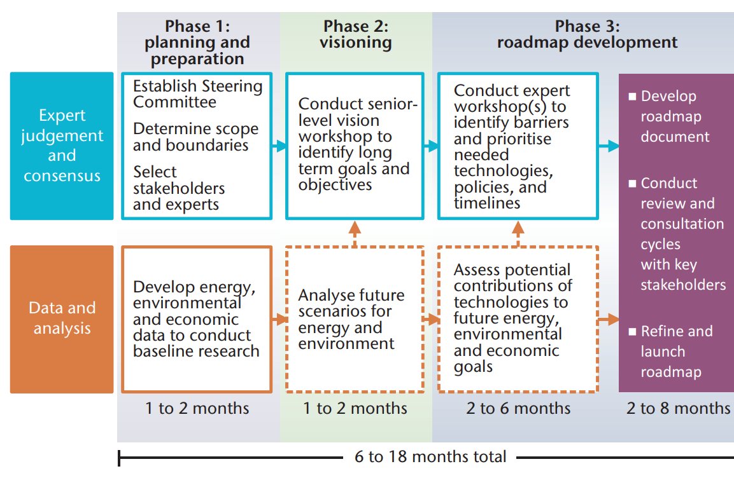
Roadmap
Commitment
Climate neutrality?
System boundaries: Campus, buildings (BIG), Scope 1+2+3?
Stakeholder from JKU
Energy situation? (often: data?)
Visioning: Targeting – what will be included?
Detailed roadmap
Source: IEA (2014): Energy Technology Roadmaps - a guide to development and implementation. Web: https://iea.blob.core.windows.net/assets/ca7594aa-1de1-4a3a-a531-121238ef5efb/TechnologyRoadmapAguidetodevelopmentandimplementation.pdf (2023-96-12)

Slide 8
Designing a roadmap
Idea
Data collection
Vision
Roadmap
…
Idea of becoming climate neutral
Data collection
Which data is already available?
How can CO2 emissions be quantified?
Vision
Clarify in detail what should be reached
System boundaries, etc.
Roadmap
Steps & measures towards implementation
Sequence and interactions
Framework interrelations

Slide 9
You may ask yourself:
What is the status of other universities?

Slide 10
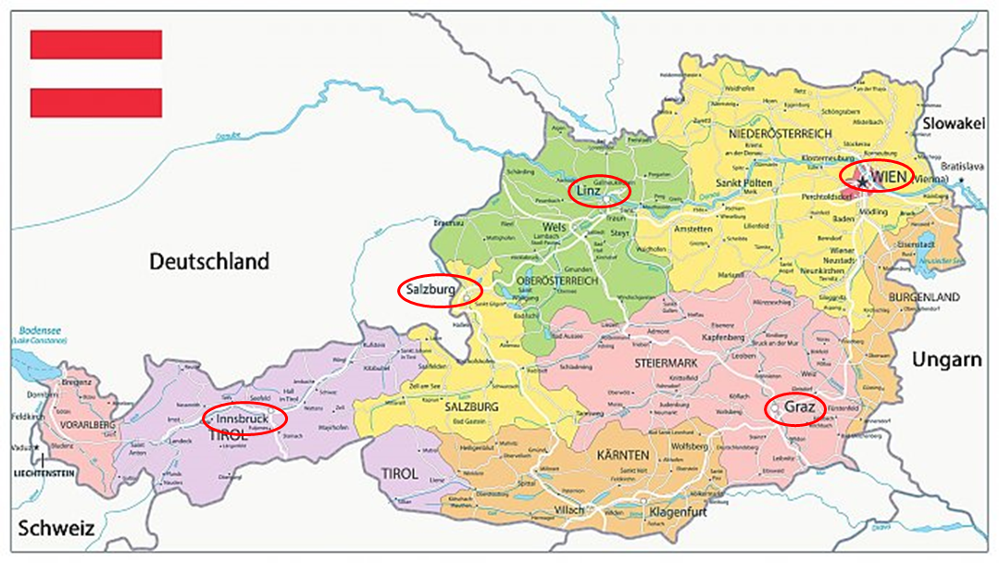
Comparison with other universities
Unis in Austria, Germany and Switzerland
Do they already have a roadmap?
If yes, how is it specified? → Copy/Paste of actions allowed
Source: Österreich Karte | Ferienhaus Österreich (ferienhaus-oesterreich.net)

Slide 11
Comparison with other universities
Key facts
Percentage share of actions by area:
Complete
roadmap: 3
24,8%
32,7%
6,9%
35,6%
Aim for becoming climate neutral:
2030: 5
2025: 1
2035: 1
Already achieved: 1

Slide 12
Comparison with other universities
Creating awareness in general: use of electricity
Energy
Energy monitoring
Use of smart meters
Obtain UZ-46 certified green power
Commuting mobility: bikes
Providing (financial support) (e-)bikes
(covered) bike spaces / boxes
Providing self-service stations, bike safety training, showers for free
Commuting mobility: cars
Extention of e-mobility
Promotion of public transport
E.g. Klimaticket
Business travel regulations
Preference of using train/bus over car/airplane

Slide 13
Data collection at JKU
JKU
Idea
Data collection
Vision
Roadmap
…

Slide 14
Data collection at JKU
Report from the Klimabündnis Österreich: Klimaschutz im Unternehmen. Klima-Check
Filtered relevant data and identified system boarders
→ Roadmap builds on available data
Energy, buildings, area listings = very detailed data
Mobility = less detailed data
Different availability per campus
Source: Spiekermann, Georg (2021): Klimaschutz im Unternehmen. Klima-Check.
Klimabündnis Österreich

Slide 15
Energy

Slide 16
Energy

Slide 17
Mobility
Employee mobility

Slide 18
Next steps
Idea
Data collection
Vision
Roadmap
Implementation
GHG Balance
(Re)Evaluation
Workshop 2 with topic „roadmap“
gathering of possible actions to be taken
detailed steps
Project runtime until end of September
Then it‘s JKU‘s turn: implementation of the roadmap
__________________
Your idea?
Survey by Betriebsrat
Send your ideas to moser@energieinstitut-linz.at

Slide 19
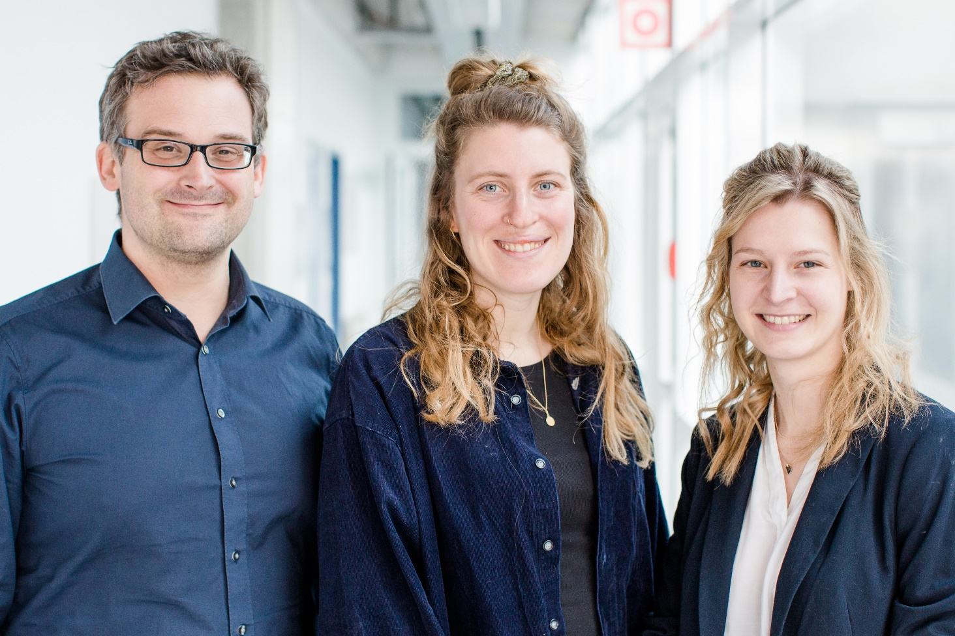
We welcome your feedback in inputs!
moser@energieinstitut-linz.at rusch@energieinstitut-linz.at knoebl@energieinstitut-linz.at

